Slide 1
Parking Management system

Slide 2
introduction
A smart vehicle parking system not only helps to look for parking but also saves time.
It is an integrated form of parking system which can help with organization of vehicle in a more efficient way.
The main problem with the existing parking system is that it cant tell how many slots are available for the parking in a parking space.
The Increasing population, leads to a greater number of private vehicles which drastically increases the number of parking space needed. So, a proper parking management system is needed.

Slide 3
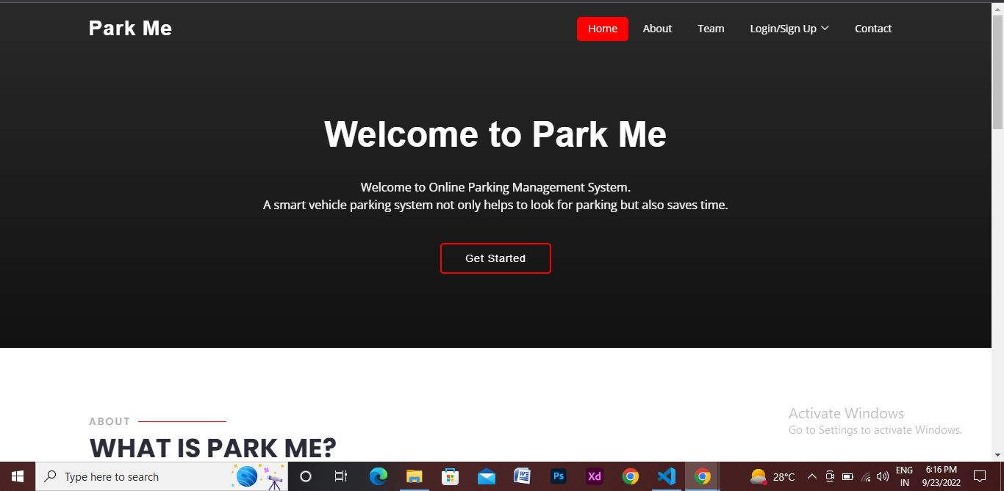
Home

Slide 4
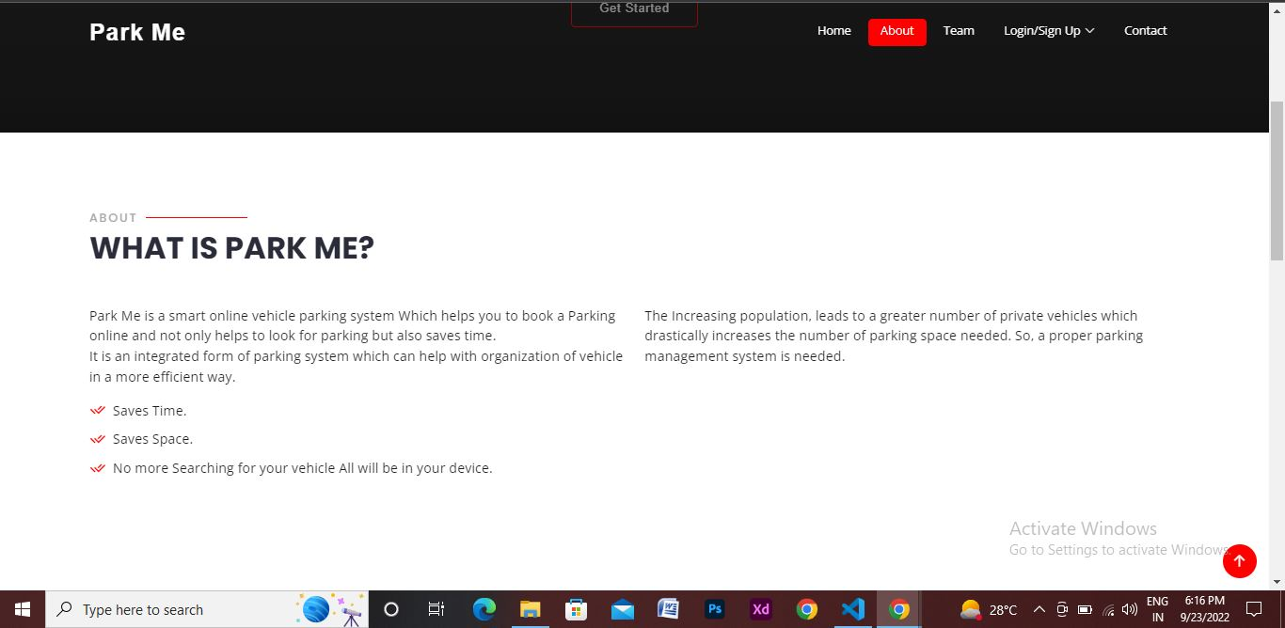
About
.

Slide 5
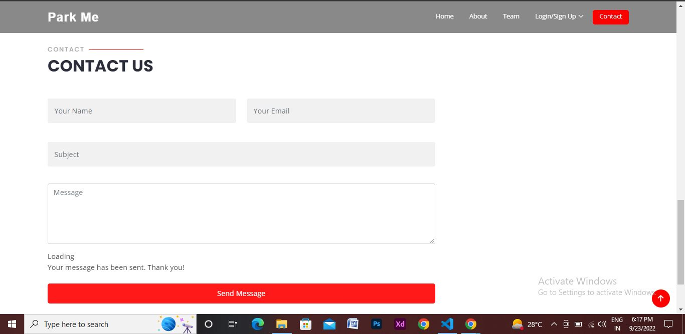
Contact us

Slide 6
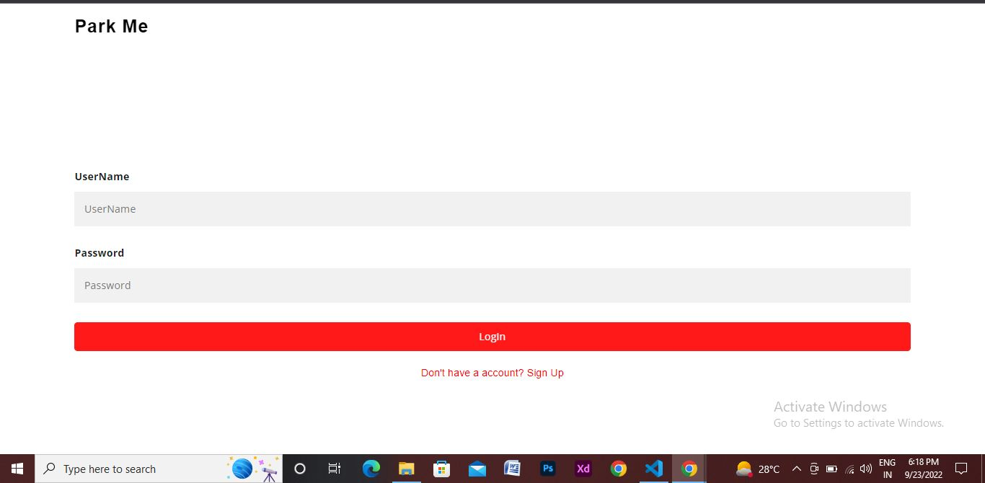
Login

Slide 7
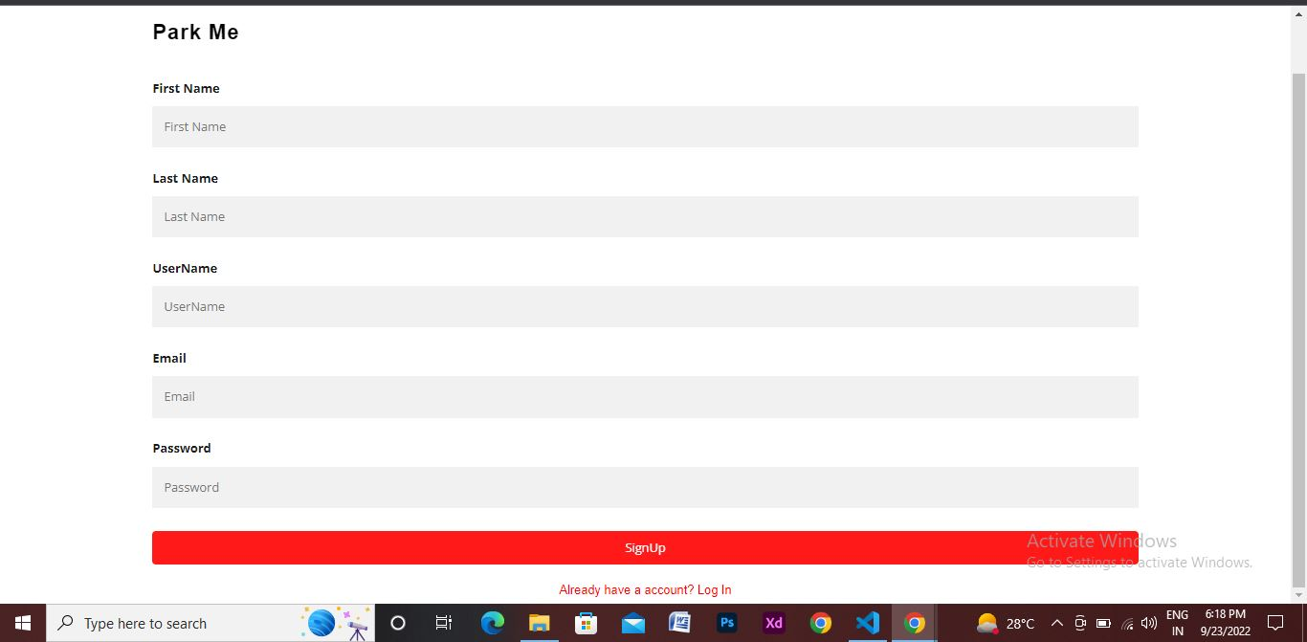
Sign up

Slide 8
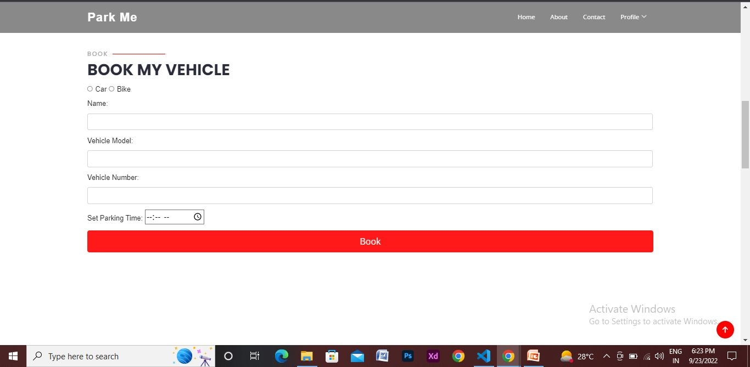
Book Parking

Slide 9
conclusion
This parking system can save time and you can book the parking earlier.
This can be used by every person who has a car or bike, and where there are a huge number of in and out of vehicles like Malls, Companies, Tourist Places you can book your parking earlier.
This new Parking system adds value to the modern day parking system.

Slide 10
Thank you

